Slide 1
A Prosecutor’s Perspective on Combating Online Child Exploitation
20 November 2025
Kristi O’Malley, U.S. Department of Justice

Slide 2



Perspective

Slide 3

Prosecutor Perspective
These cases are difficult to prosecute.
Why?

Slide 4
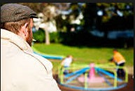

Parent Perspective
Then and now:

Slide 5
Topics
What is the threat?
What can we do?

Slide 6

The Internet

Slide 7
Current Online Threats
Sextortion / Cyberbulling
Enticement/Abduction
Darkweb
Livestreaming / Live Audience
Crowdsourcing
Virtual Sex Trafficking
International Sex Tourism
AI-Generated Images

Slide 8

Sexting
Statistics vary widely on percentage of teens involved
in sexting
Both girls and boys
Wide distribution easily and quickly
Cannot get images back

Slide 9
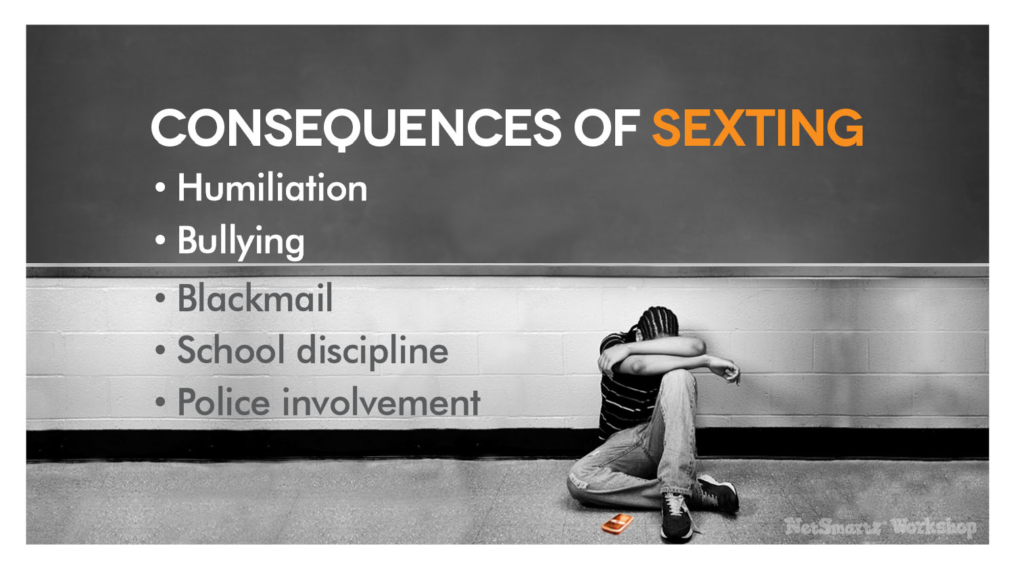
9

Slide 10

Sextortion
10

Slide 11
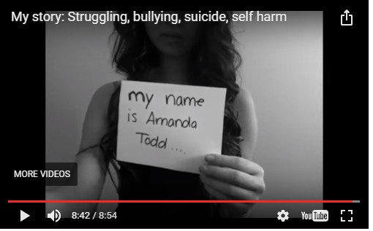
11

Slide 12
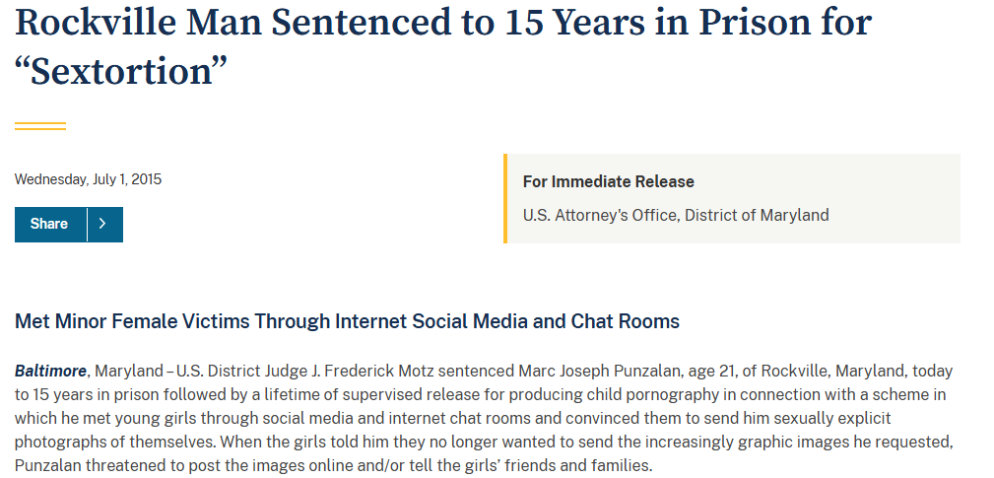
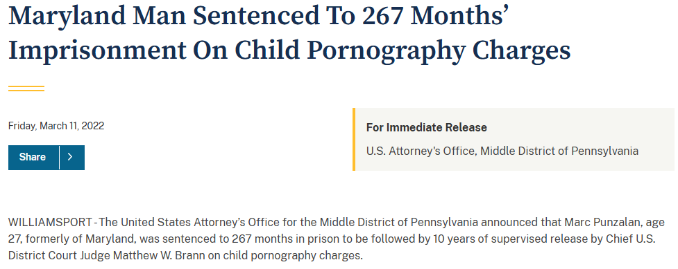
Total Sentence:
30 years in prison
12

Slide 13
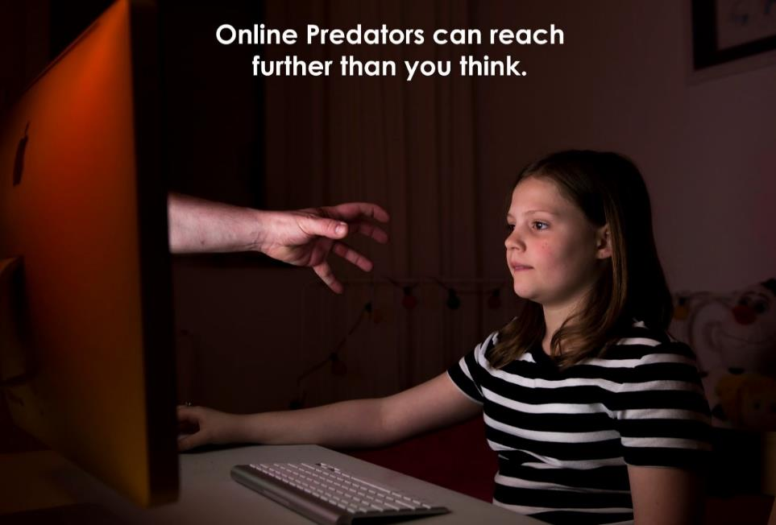
Enticement and Abduction
How do predators work?
  Assume an identity;
  Meet potential victim online;
  Groom victim;
  Meet up.

Slide 14
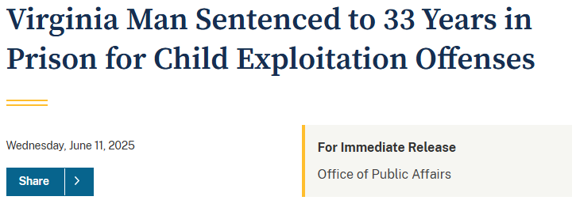
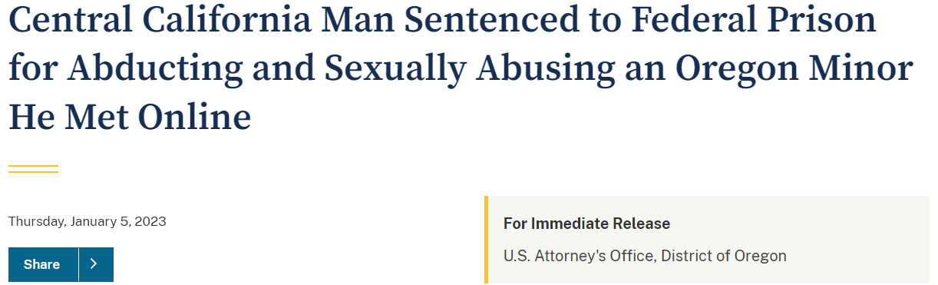
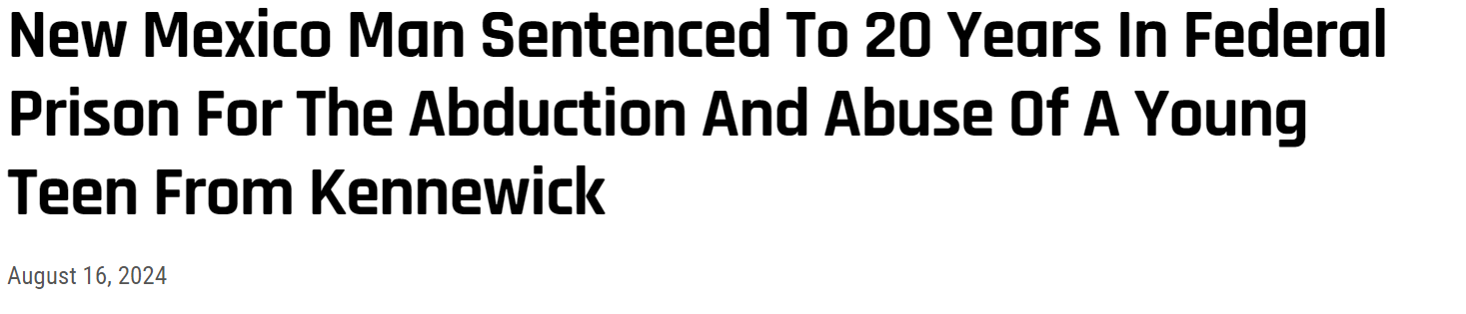
14

Slide 15
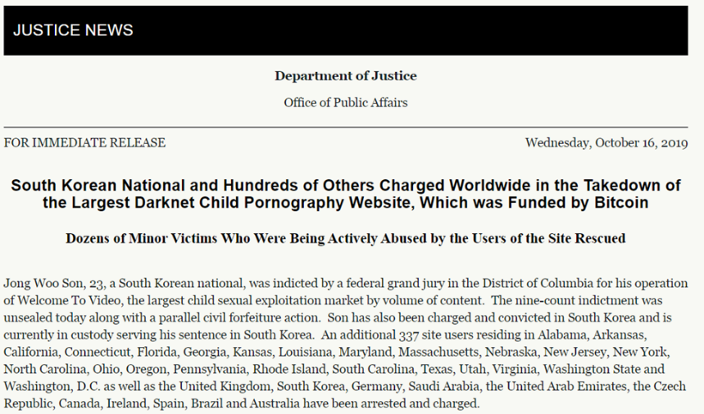
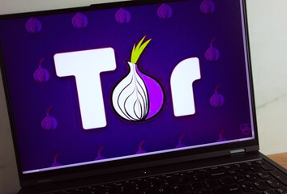
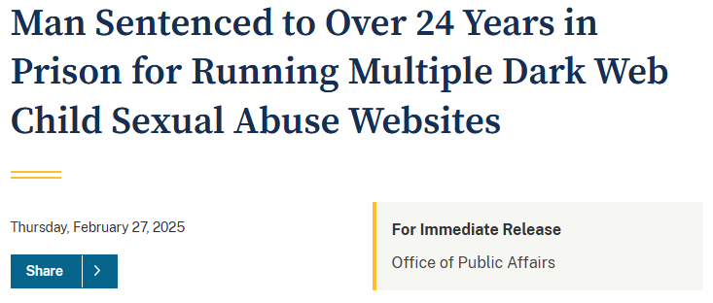
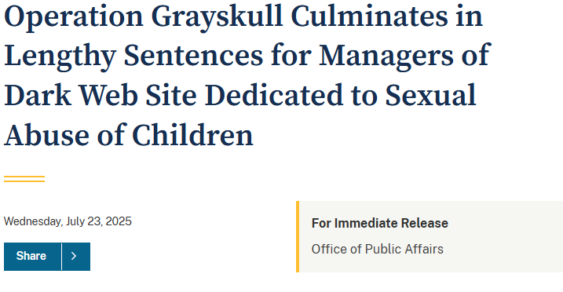
Dark Web

Slide 16

Livestreaming / Live Audience
Offenders meet in live groups to participate in and view sexual abuse of a child.
Special requests
Abuse recorded as it occurs

Slide 17

Crowdsourcing

Slide 18
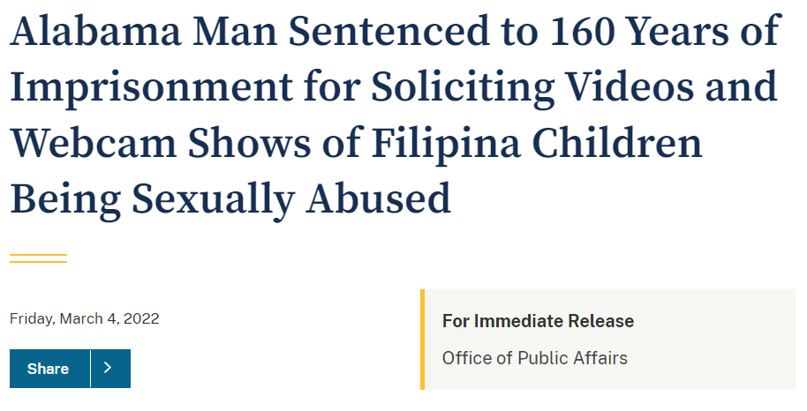
Virtual Sex Trafficking

Slide 19
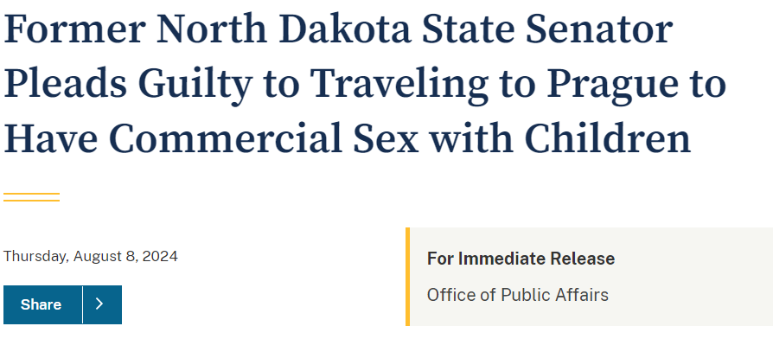
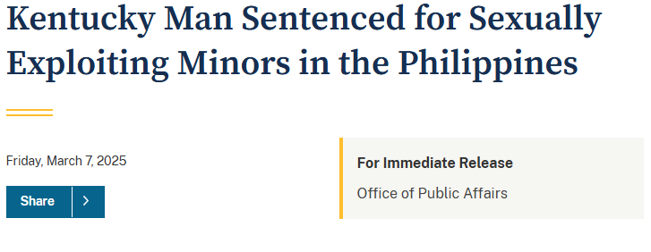
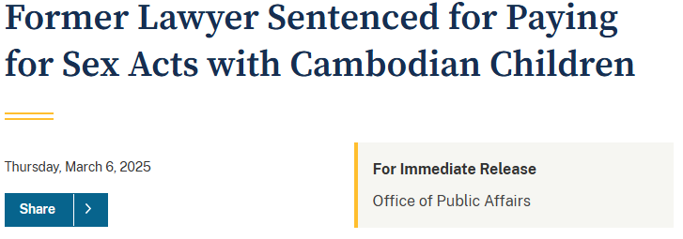
International Sex Tourism

Slide 20
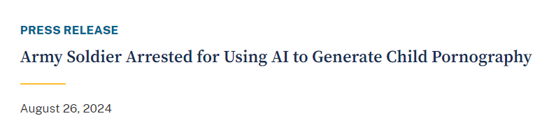
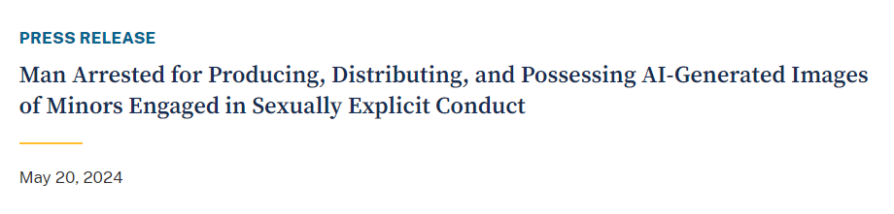
AI-Generated Child Sexual Abuse Material

Slide 21

What can we do?
Governments
Law Enforcement
NGOs
Private Industry
Academics
Victim Advocates
Parents

Slide 22
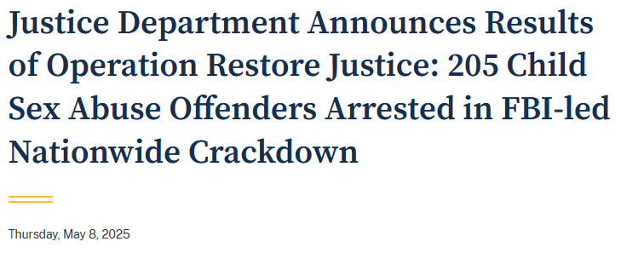
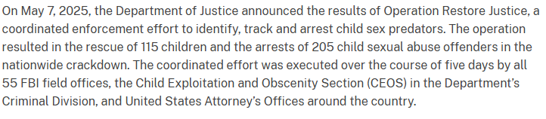

Slide 23
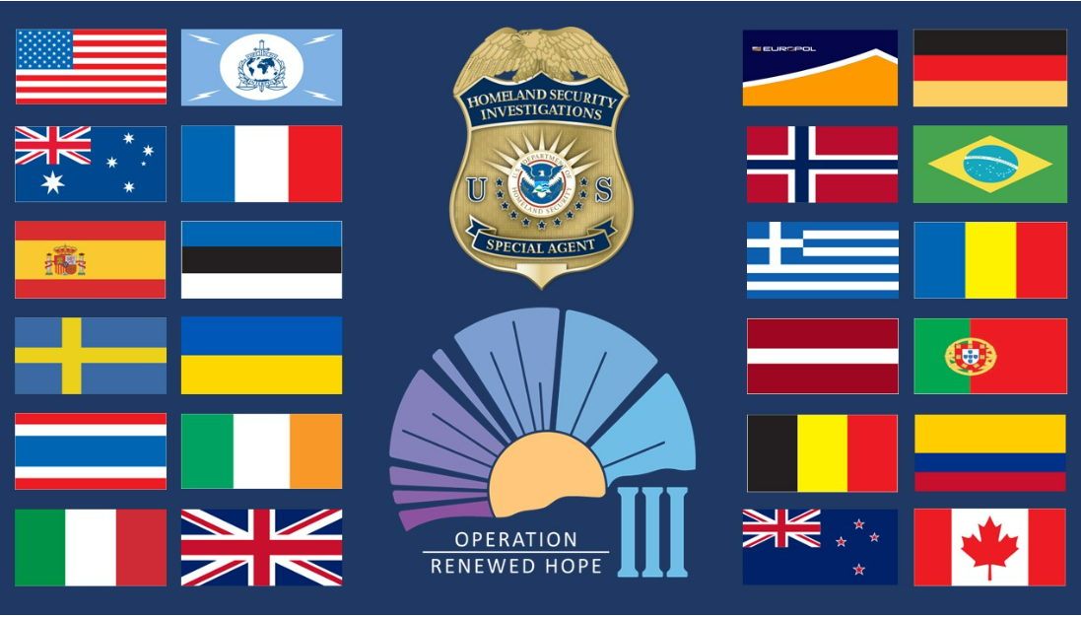

Slide 24
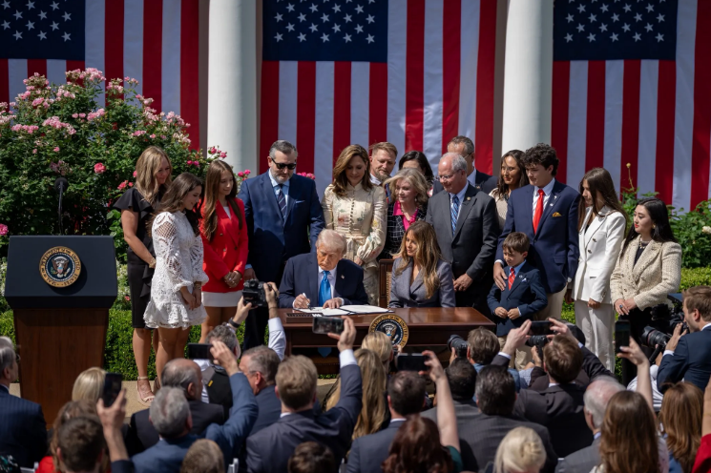
TAKE IT DOWN Act

Slide 25
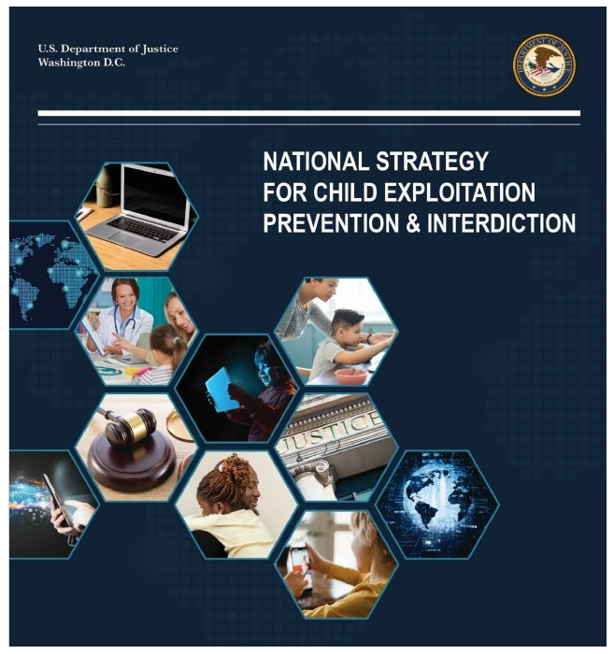

Slide 26
Thank You!
Kristi O’Malley
ICHIP Attorney Advisor
U.S. Department of Justice

